Slide 1


Global Olympic Dataset Diagnosis using Power BI
NAME : Ravuri Yasaswi Venkata Naga Sravani
AICTE ID : STU6464b4d2cdec61684321490
COLLEGE : Shri Vishnu Engineering College for Women

Slide 2

PROBLEM STATEMENT
How can we create an interactive Power BI dashboard that effectively visualizes Olympic Games data, enabling users to explore and analyze historical performance metrics, identify trends, and gain insights into athlete and country performances across different sports disciplines?

Slide 3
Project Description
This repository features a cutting-edge Power BI dashboard designed to provide an immersive and interactive analysis of Olympic Games statistics.
Utilizing a wide array of chart types and applying numerous filters, users can delve into a wealth of historical data to discover top-performing countries and athletes, analyze the gender distribution of medals, and track yearly trends.
The dashboard offers a comprehensive view across various sports disciplines, delivering valuable insights for sports analysts, enthusiasts, and professionals alike.
Explore and interact with the data to uncover patterns, trends, and key performance metrics in the world of Olympic sports.

Slide 4

WHO ARE THE END USERS
Sports Analysts
Coaches and Athletes
Sports Enthusiasts and Fans
Researchers and Academics
Journalists and Media Personnel
Sports Organizations and Committees
Educational Institutions

Slide 5

Technology Used
Power BI
Data Source : Excel
Transformation Tool : Power Query
Power BI Custom Visuals
Version Control : Git/GitHub

Slide 6
DASHBOARD DEVELOPMENT PROCESS
DATA LOADING & CLEANING
LOADING THE DATA
Imported the dataset from Excel, covering Olympic Games statistics from 1972 to 2016 for both Summer and Winter Olympics.
DATA CLEANING
Removed Null Values
Eliminated Duplicated
Filtered out Unwanted Columns

Slide 7
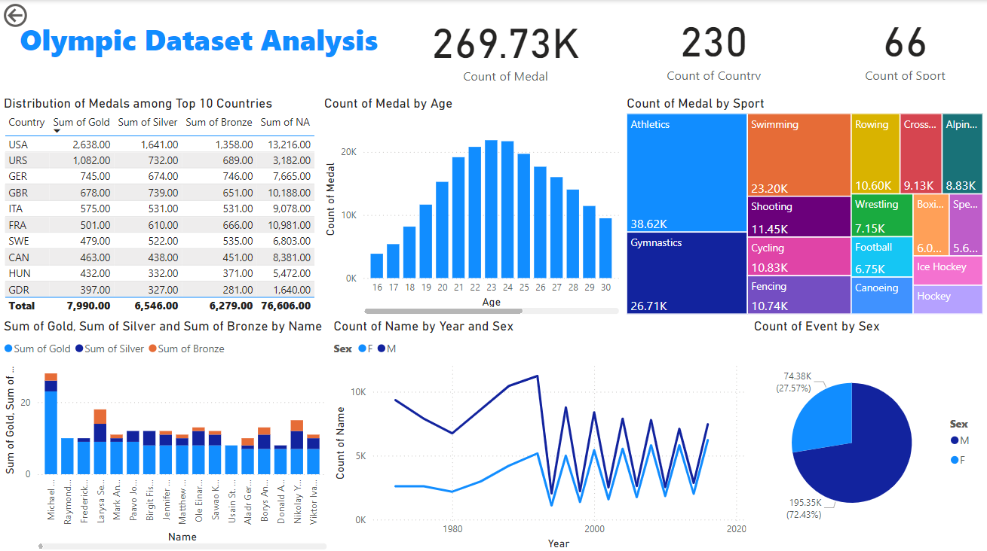
RESULT
TAP HERE TO VIEW

Slide 8

.
.

